Slide 1

Sparkathon,23
Team Name:
Team Members:
Addwit Saxena
Ayushi Rai
Prince Yadav
Yashaswi Aryan

Slide 2
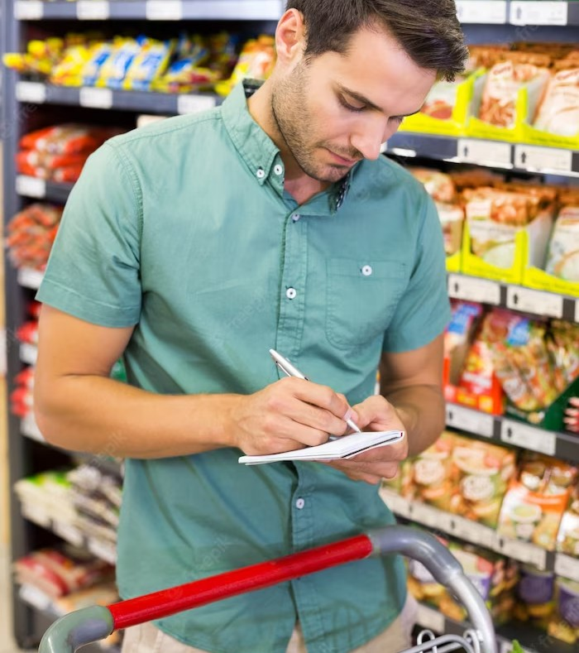
Problem Statement
Limited Visual Representation of Unpacked Products:
Unpacked items like fruits, vegetables, and grocery products in physical supermarket stores lack comprehensive visual representation, unlike their digital counterparts in grocery apps.
Inadequate Information for Informed Choices:
Consumers face challenges in accessing vital details such as freshness, nutritional information, and import source for unpacked edible items, leading to difficulties in making informed purchasing decisions.
Need for Enhanced Transparency and Accessibility:
There is a growing demand for improved transparency through visual and informative cues on unpacked products in-store, bridging the gap between the online and offline shopping experiences.

Slide 3
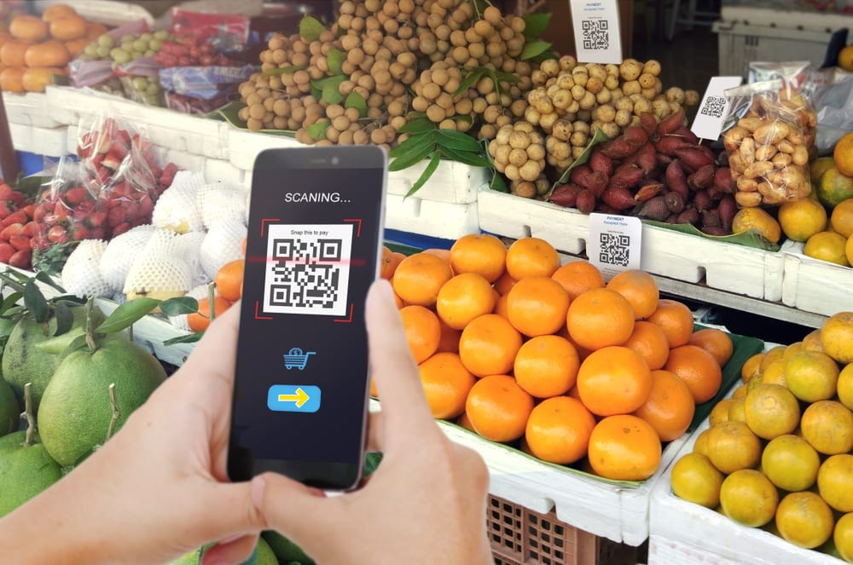
EasyScan
ǪR Code Enabled Information Display for Enhancing Consumer Experience
Emerging Technology

Slide 4
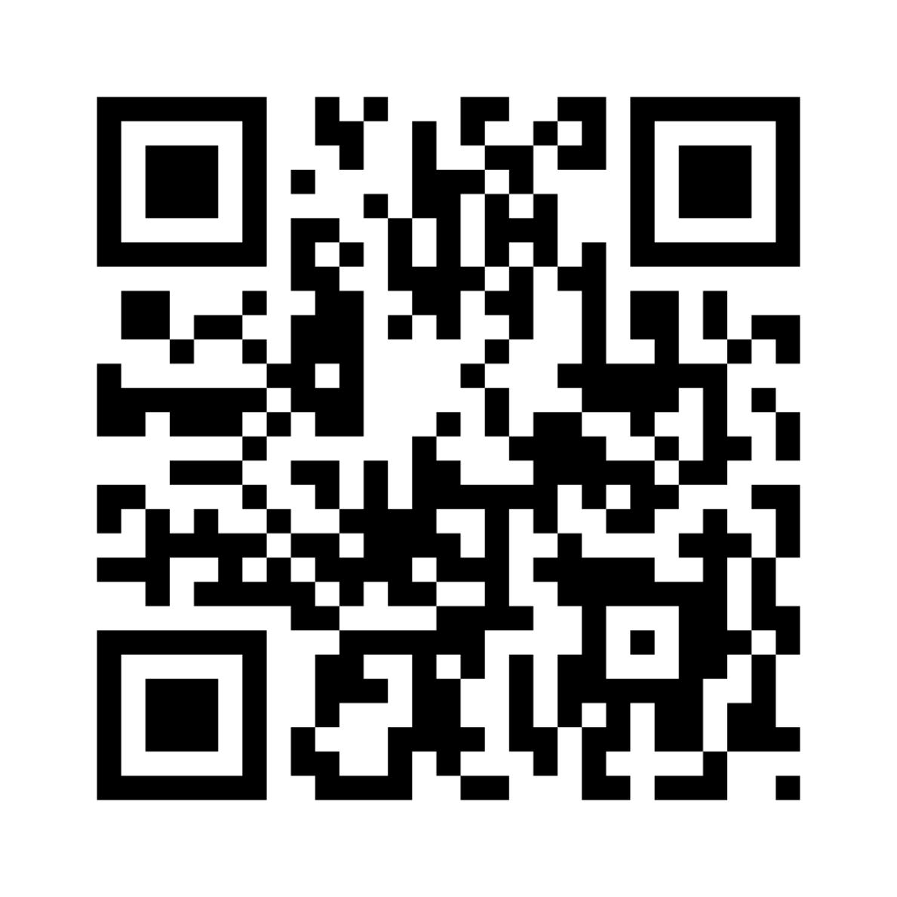
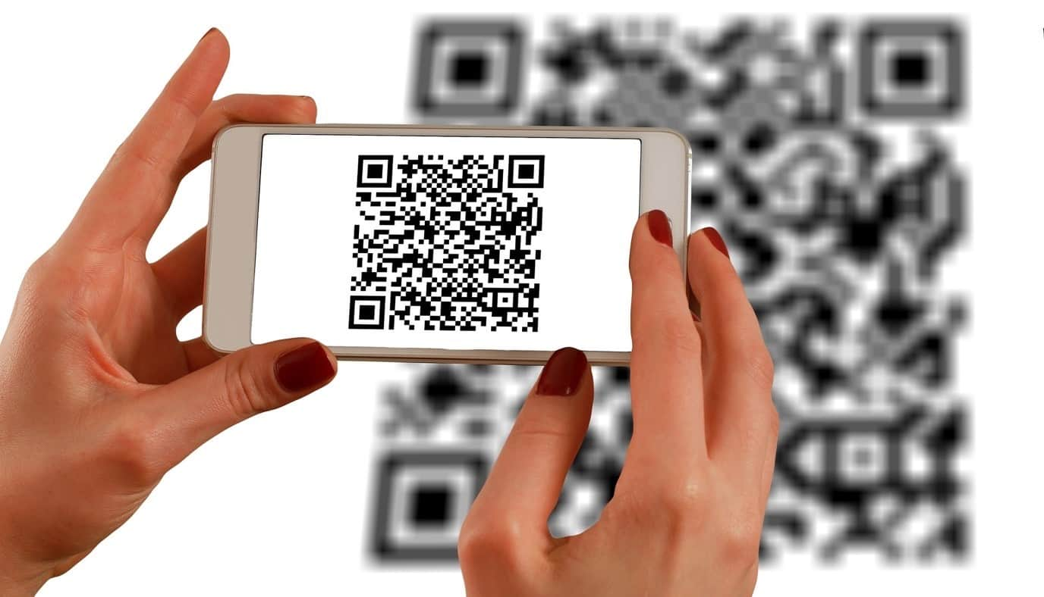
QR code
Quick Response Code (or QR Code) is a machine-readable code consisting of an array
of black and white squares, typically used for storing URLs or other information for
reading by the camera on a smartphone.

Slide 5
proposed concept

Slide 6
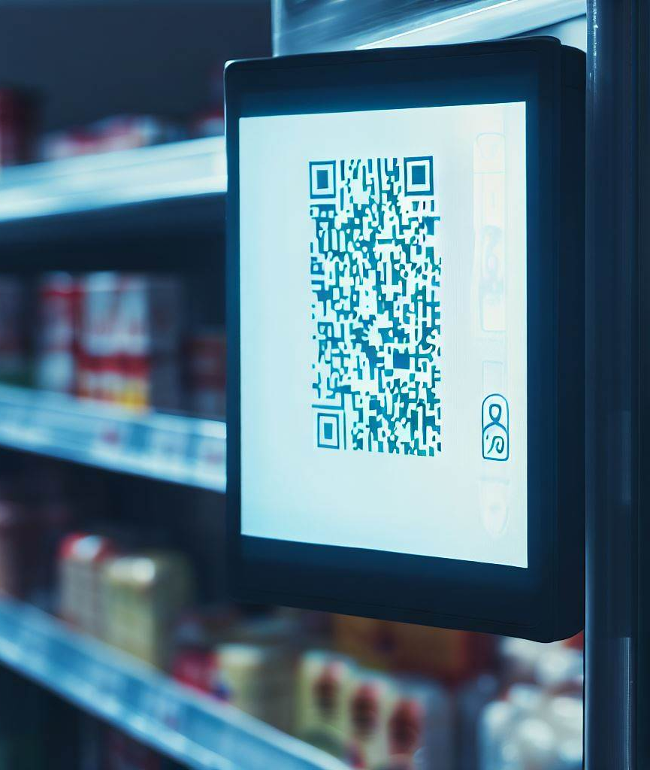
Automated QR Code Generation:
Upon product arrival at Walmart stores, the inventory management system will automatically initiate our integrated application to create QR codes for each item.
Precise Shelf Placement:
The QR codes will be dynamically assigned to the exact shelf location where the corresponding product is to be stocked, ensuring accuracy and efficient retrieval.
Digital Display Implementation:
Instead of traditional paper labels, QR codes will be showcased on digital screens strategically positioned near the respective shelves, minimizing

Slide 7
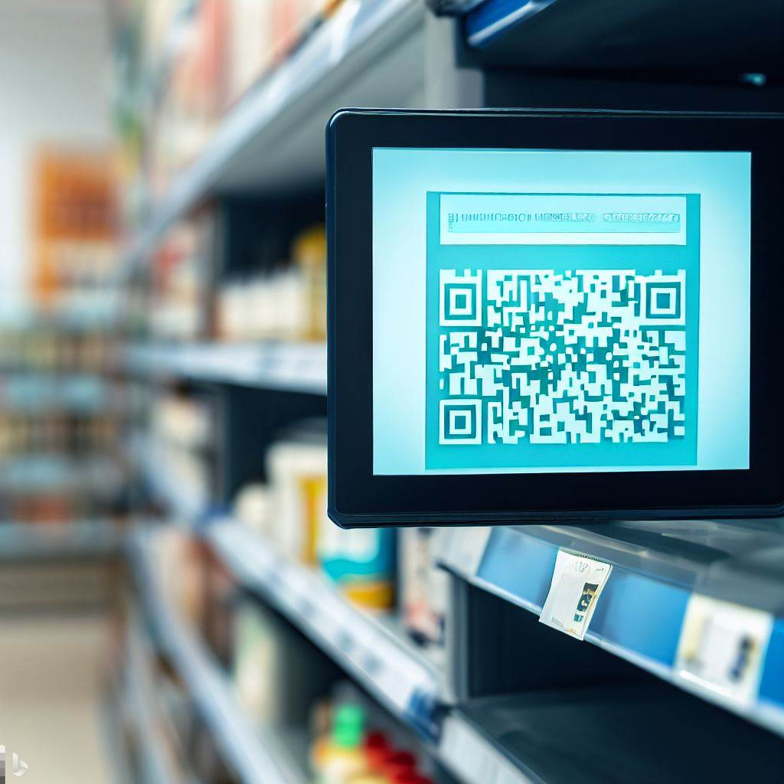
Comprehensive Information Access:
Each QR code will link to a user-friendly interface, offering a gateway to essential product details such as nutritional information, seller credentials, manufacturing and expiry dates, as well as the origin source provided by the seller.
Seamless Consumer Interaction:
Shoppers can easily scan the QR codes using their smartphones, enabling instant access to specific product information and fostering a more transparent and informed shopping experience.

Slide 8
Proof of concept (POC)

Slide 9
HIGH LEVEL OVERVIEW

Slide 10
demo

Slide 11
conclusion

Slide 12
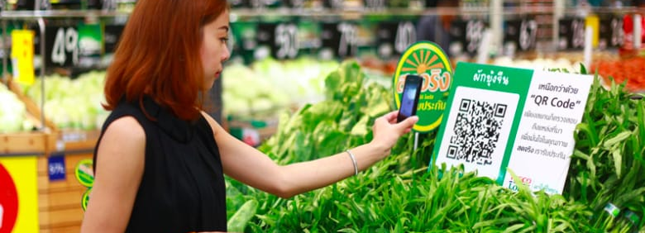
QR code-enabled shelf information beneﬁts both consumers and retailers.
Consumers save time and make informed decisions, while retailers increase sales by as QR codes provide a transparent and engaging way to present product information, building trust and encouraging repeat business.
Real-time updates also reduce waste and improve inventory management

Slide 13
Thank you

